Slide 1
SITUATIONAL REPORT
ST. JOSEPH’s HOSPITAL, JIRAPA
4TH QUARTER 2022

Slide 2
UPDATE ON HOSPITAL STATE
PERIOD UNDER REVIEW:
JANUARY 2022 – DECEMBER 2022

Slide 3
Major Concerns: YEAR 2022
Decrease in hospital mortality rate and improvement in health information performance indicators
Provision of mental ward with addiction rehabilitation
Provision of pharmacy and laboratory annex
Provision of hospital staff/client canteen
Renovation of hospital infrastructure
Repair and maintenance of hospital fleet - transportation
Provision of wireless GSM phone set to all wards and units
Improve on security issues (Human resource, Central security personnel, Training, CCTV)
Move the hospital from folder to paperless system – LHIMS/Elephant
Provision of modern medical equipment (Project cure, IGF, Philanthropists)
Extension of infrastructure (Mortuary, NICU, Labour ward)
Provision of Obstetrics/Gynaecology theatre at maternity ward
Rewiring of electrical system to prevent frequent breakdown of equipment and gadgets
Provision of new incinerator pit
Improvement on procurement processes and logistic supply chain (Logistics committee)
Enhancement of Hospital environment
Refurbishment of Religious ward
Changing of Mortuary exit point
Renovation of hospital bungalows
Covering of ward mattresses

Slide 4
Major Activities Carried Out
Held weekly clinical meetings, NND audits and monthly mortality conferences
Major and minor renovation works on hospital infrastructure
Organised 4 quarterly blood donation exercises
Held Family Health Conference with hospital stakeholders
4 Surgical outreach programs at hospital
Staff medical subsidy policy – 283 staff
Health education ongoing twice every week at Radio Gangaa
Staff identification – nametags (343 staff)
Staff health screening (8th-12th August 2022) – 219 staff
Organized regular in-service trainings for staff
Held 4 quarterly staff durbars
External auditing of facility (Ghana audit service, GRA)

Slide 5
HUMAN RESOURCE
CATEGORY | CHAG | GHS | CASUALS | TOTAL
Medical Officer | 2 | 3 | 0 | 5
Physician Assistants | 3 | 0 | 6 | 9
Community Nurses | 10 | 0 | 1 | 11
Registered General Nurses | 56 | 26 | 8 | 90
Midwives | 26 | 27 | 6 | 59
Enrolled Nurses | 55 | 22 | 0 | 77
Allied Health | 20 | 15 | 4 | 39
Admin & Support staff | 43 | 1 | 0 | 44
Pharmacist and Technicians | 3 | 0 | 1 | 4
Other Staff | 13 | 6 | 66 | 85
Total | 231 | 106 | 92 | 429
NSS - 32, STUDY LEAVE - 45

Slide 6
MENTAL WARD PROJECT

Slide 7
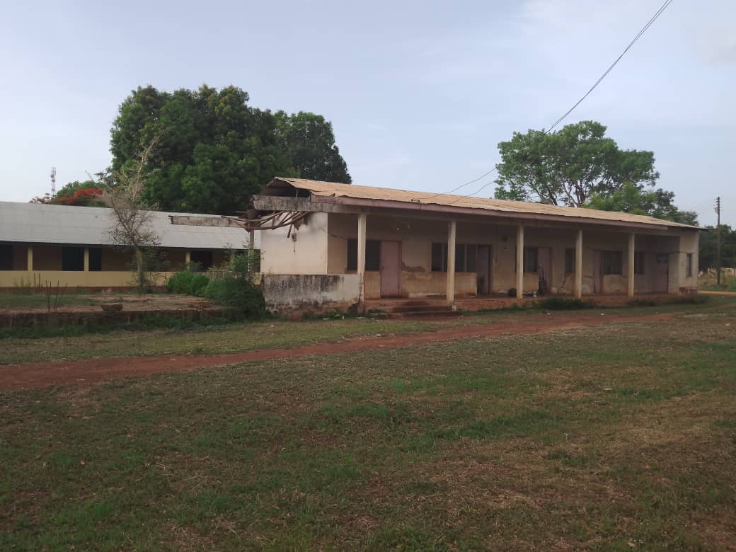

Slide 8
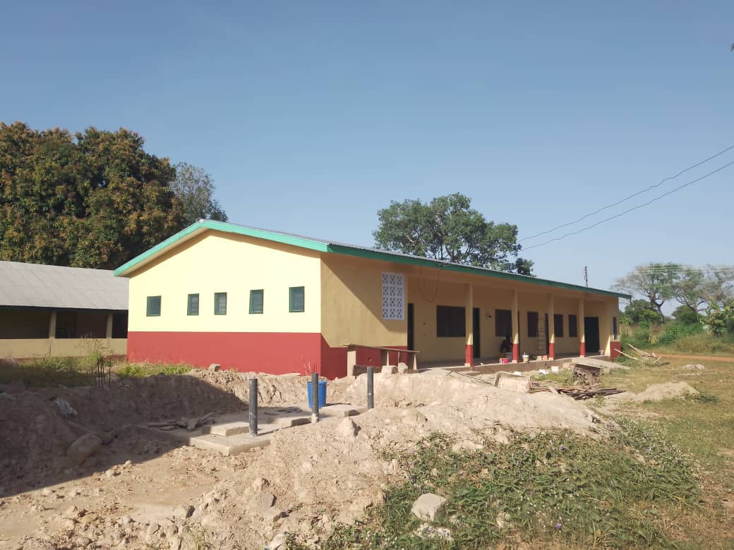

Slide 9
CANTEEN PROJECT

Slide 10
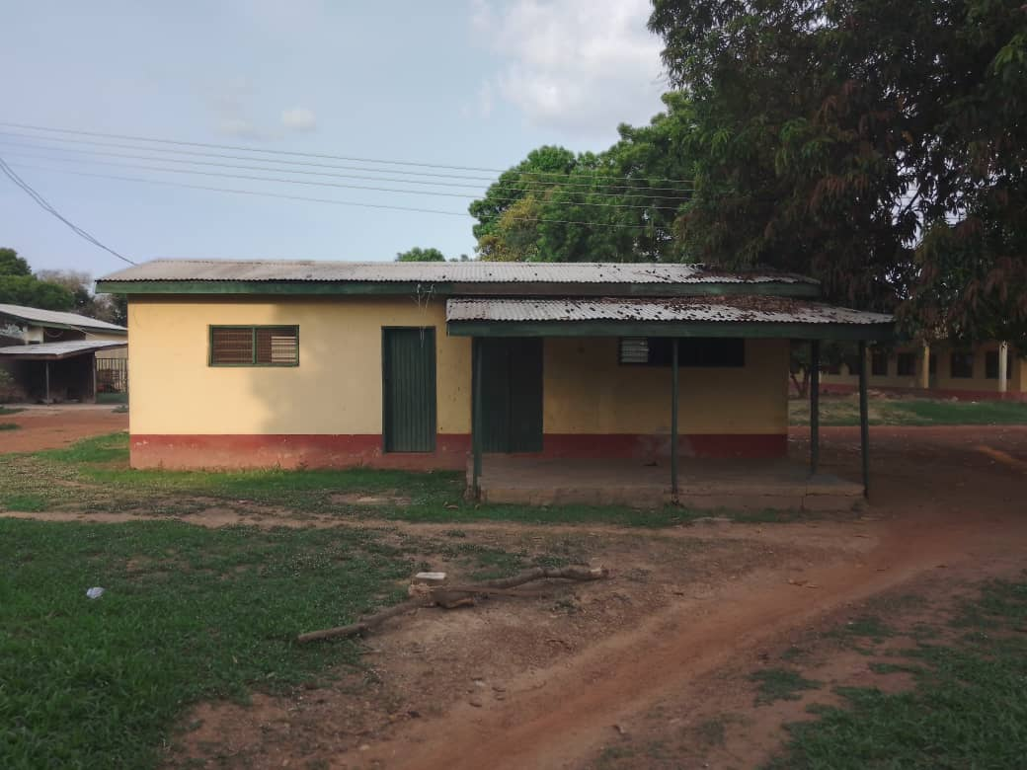

Slide 11
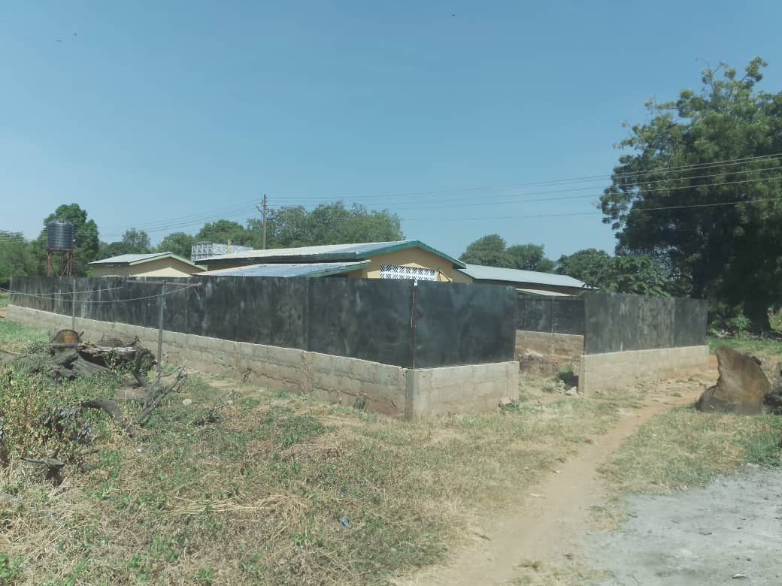

Slide 12
PHARMACY ANNEX

Slide 13
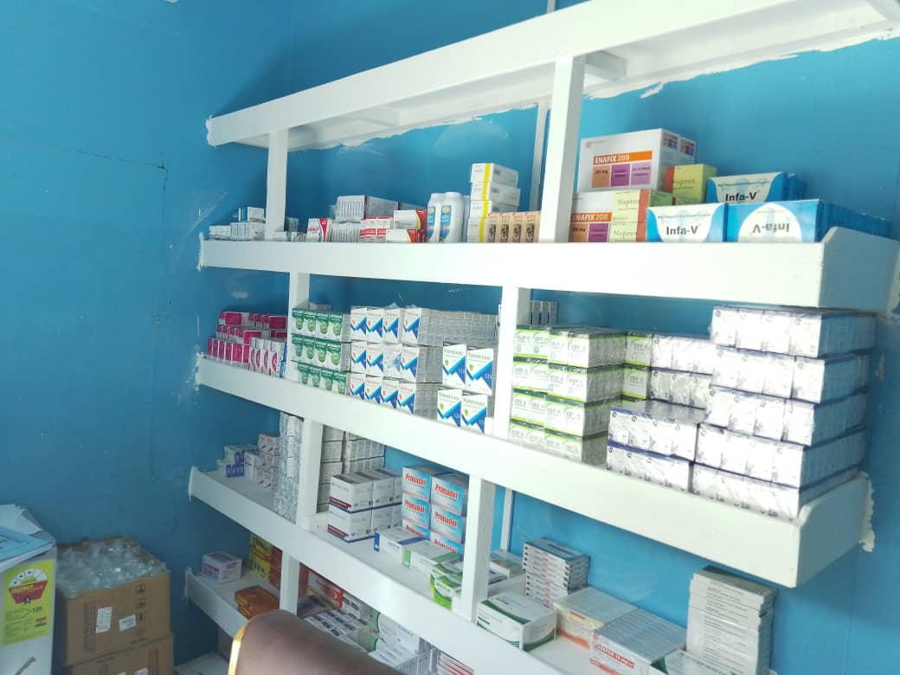
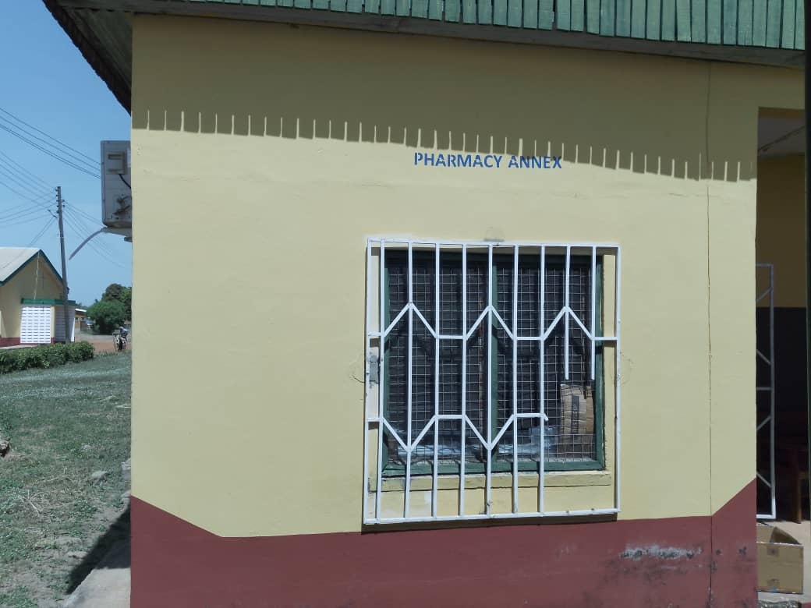
IPD PHARMACY

Slide 14
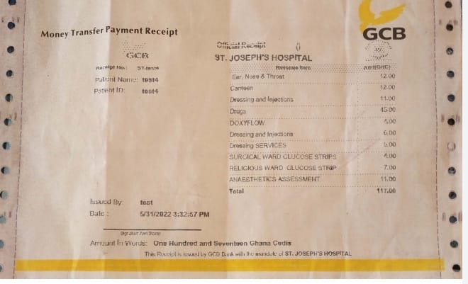
GCB – ONSITE + INTERNET BANKING

Slide 15
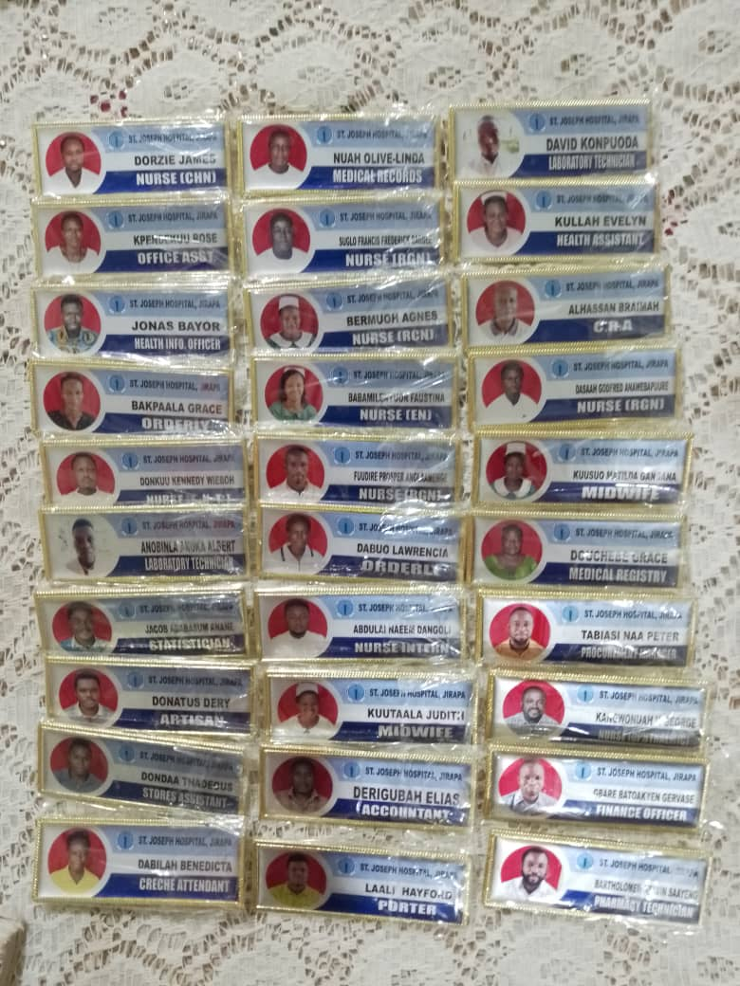
STAFF NAMETAGS

Slide 16
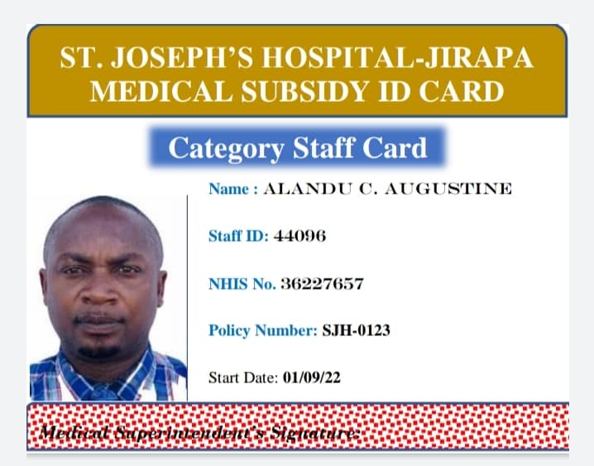

Slide 17
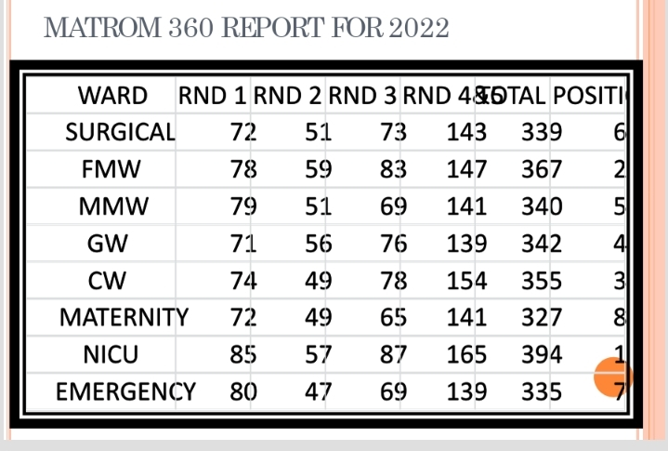

Slide 18
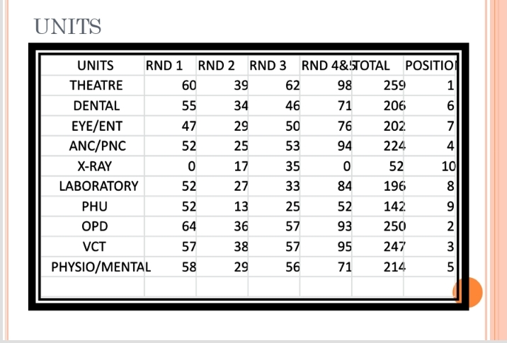

Slide 19
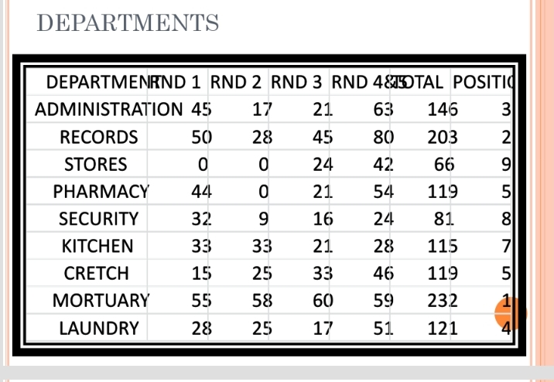

Slide 20
CHALLENGES - 1
Lack of modern medical equipment
Financial challenges
  Delay in NHIS re-imbursement
  Low IGF generation
  Increasing cost of supplies and unfavourable payment terms
Infrastructural challenges
  Dilapidated existing structures
  Uncompleted Administration block
  Lack of accommodation for critical staff
  Limited space at NICU, labour ward and mortuary
  Proposed theatre at Maternity (not yet done)
  Uncompleted road and gutter construction

Slide 21
CHALLENGES - 2
Human resource challenges
  Absence of specialists eg. Paediatrician, Obstetrician/Gynaecologist, Neonatologist, Surgeon, Peri-operative nurses
  Inadequate staffing eg. laboratory
  Increased number of casuals and payroll issues
  Staff filing/records limitations
Other challenges
  Delays and inconsistencies in logistic supplies
  Poor staff equipment maintenance culture and wastage

Slide 22
ACHIEVEMENTS - 1
Decreased general hospital mortality rate
Inception of ANC classes
Community communal labour support
Provision of new incinerator pit
Provision of nametags for staff
Overall best hospital in regional peer review
New digital mobile X-ray machine
Inception of Matron 360 quality assessment program
Drafting of Hospital strategic plan 2022-2027
Inception of pharmacy annex (IPD pharmacy)
Inception of G6PD and viral load tests at laboratory

Slide 23
ACHIEVEMENTS - 2
Improved referral system
Inception of staff medical subsidy policy
Refurbishment of Religious ward (4 TVs and 4 Fridges)
Provision of wireless GSM phone sets to wards/units
Covering of ward mattresses
Extension of CCTV to hospital’s main entrance
Staff health screening
4 visiting surgeons outreach programs to hospital
Provision of information desk for client complaints
Inception of On-site/Internet banking (GCB)
Repair of hospital transportation fleet

Slide 24
ACHIEVEMENTS - 3
Renovation of COVID-19 isolation center
Separation of OPD from Emergency unit
Twice weekly radio health talks
Pre-operation room at theatre
Physician specialist and Emergency nurse as staff
Procurement of new surgical instruments to theatre
Construction of new billing units
Active hospital public address system
Conducted in-service trainings for staff
Renovation of hospital bungalows
New haematology analyser for laboratory

Slide 25
WAY FORWARD - 1
To repair and replace broken down and old/ outmoded medical equipment
Lobby with NHIA for prompt re-imbursement
Engage philanthropists and organizations for support (Project C.U.R.E)
Continue lobby with Regional minister, MOH, MCE & MP to complete new administration block, hospital road and gutter construction and other structures
To transition from folder to paperless system - LHIMS
To introduce clock-in/out system

Slide 26
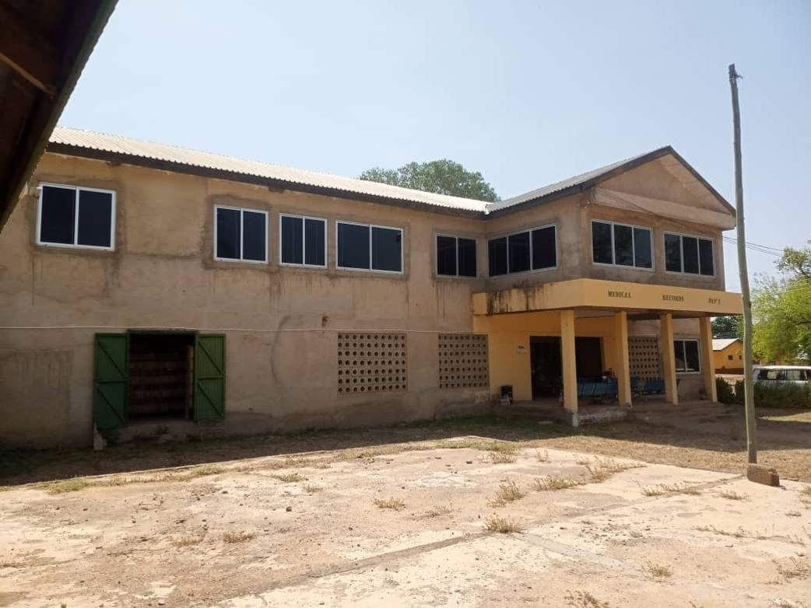
UNCOMPLETED NEW ADMINISTRATION BLOCK

Slide 27
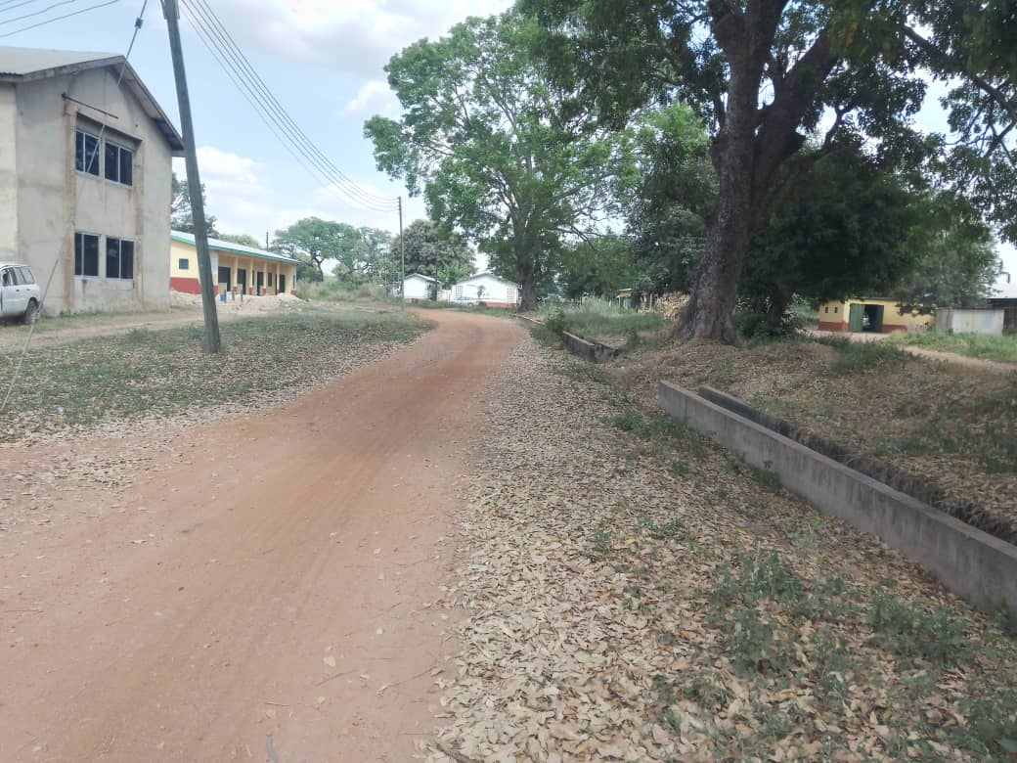
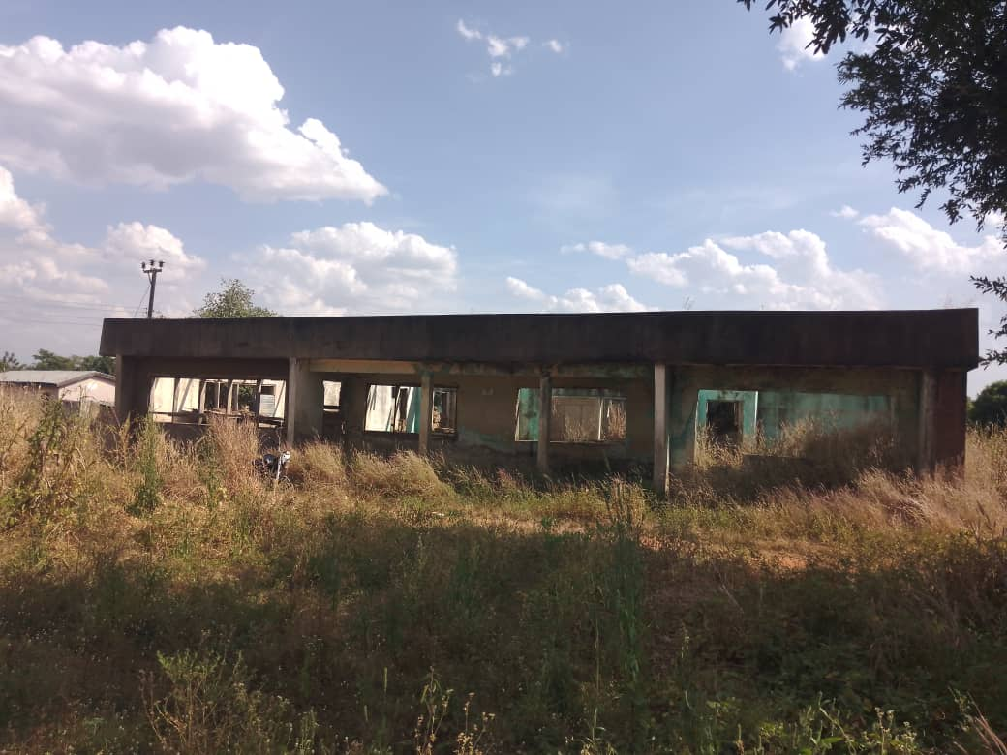
HOSPITAL ROAD AND GUTTER CONSTRUCTION/ DILAPITATED HOSPITAL BUNGALOW

Slide 28
WAY FORWARD - 2
Provision of laboratory annex
Construction of oxygen plant and medical gas pipeline system
Improvement of IGF packages to improve hospital revenue (cost recovery)
Collaboration with Zipline Ghana for drone supply of blood, blood products and emergency drugs.
Implementation of hospital accommodation policy
Procurement of Hb electrophoresis and Coagulation machines for laboratory
Estate developer contract for staff accommodation (BOT)
End of year staff awards
70th anniversary next year (2023)

Slide 29
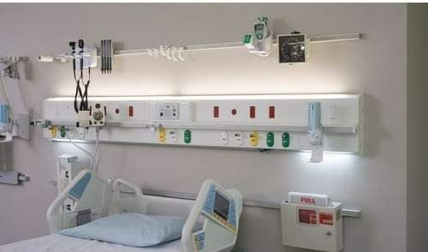
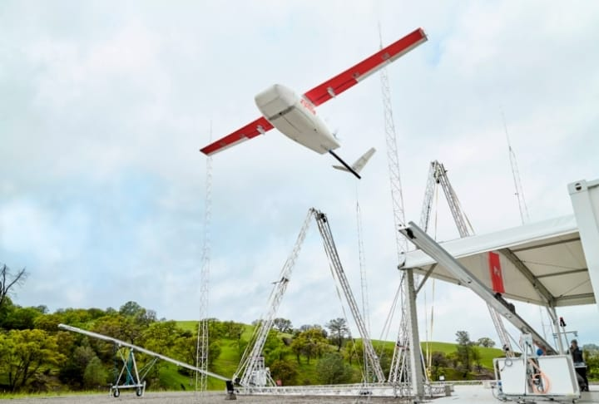
MEDICAL GAS PIPELINE SYSTEM
ZIPLINE GHANA

Slide 30
WAY FORWARD - 3
Lobby for specialists to do surgeries at hospital
Specialty units to do outreaches to community
Input of casual staff into controller payroll
Conversion of current conference room at maternity into Obstetrics and Gynaecology theatre
Provision of Mental ward (refurbishment/training)
Provision of Staff canteen (ongoing/outsourcing)
NICU and Mortuary extension
Operationalisation of theatre recovery ward
Provision of sheds for patient relatives
Extension of CCTV cameras to stores

Slide 31
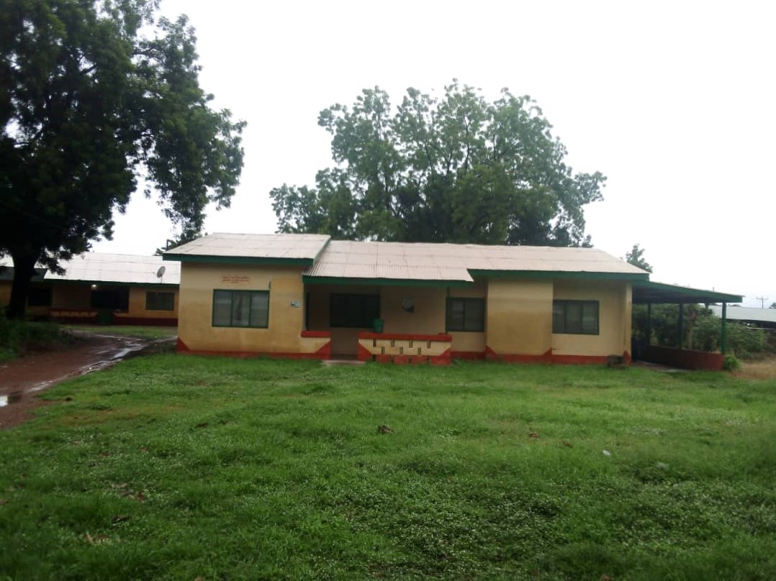
COVID 19 ISOLATION CENTRE

Slide 32
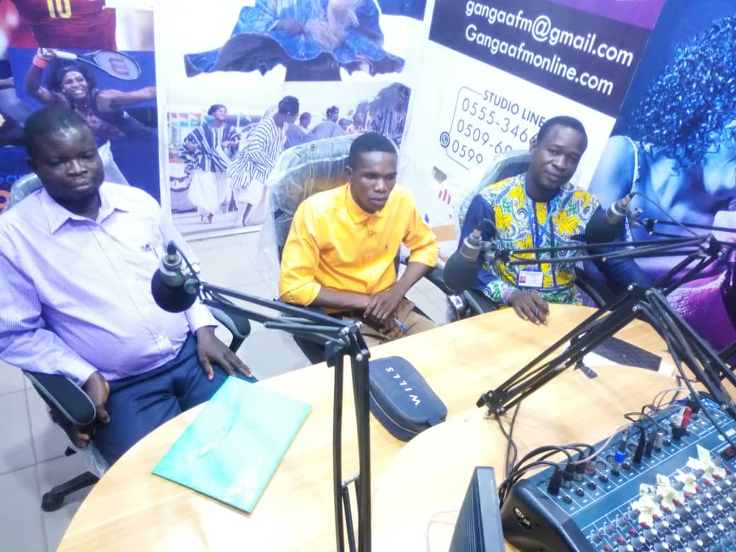
RADIO HEALTH TALK AT GANGAA FM

Slide 33
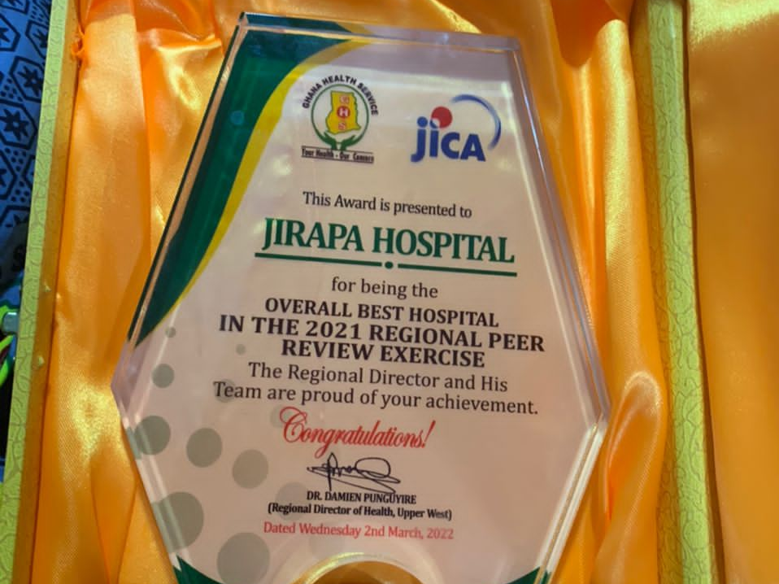
OVERALL BEST HOSPITAL – REGIONAL PEER REVIEW

Slide 34
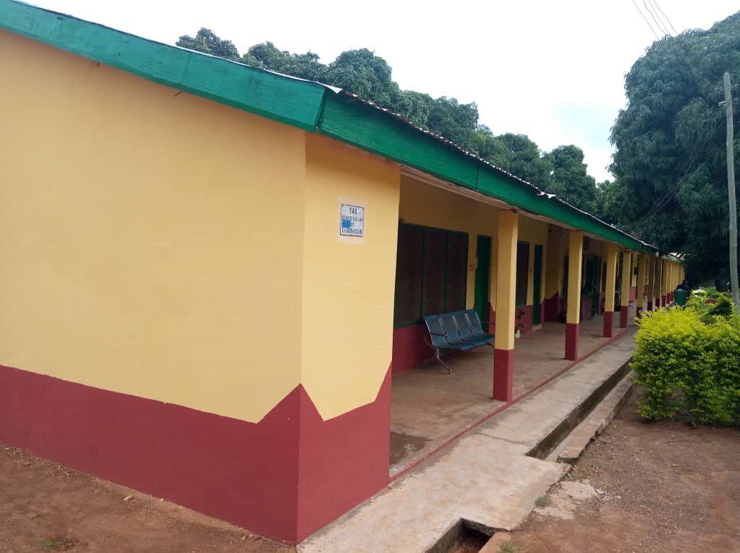
RENOVATION AND MAINTENANCE

Slide 35
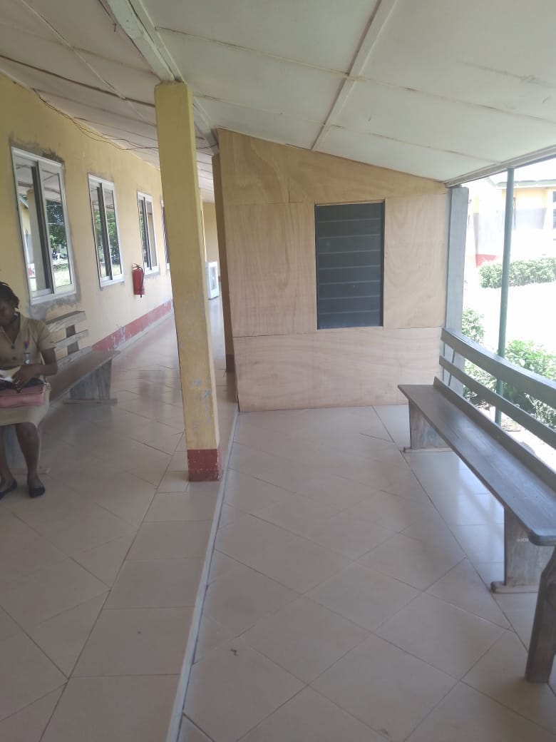
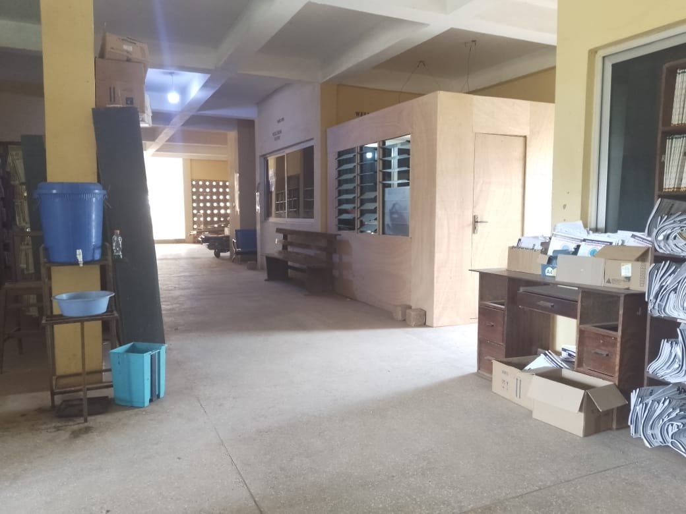
TWO NEW BILLING UNITS

Slide 36
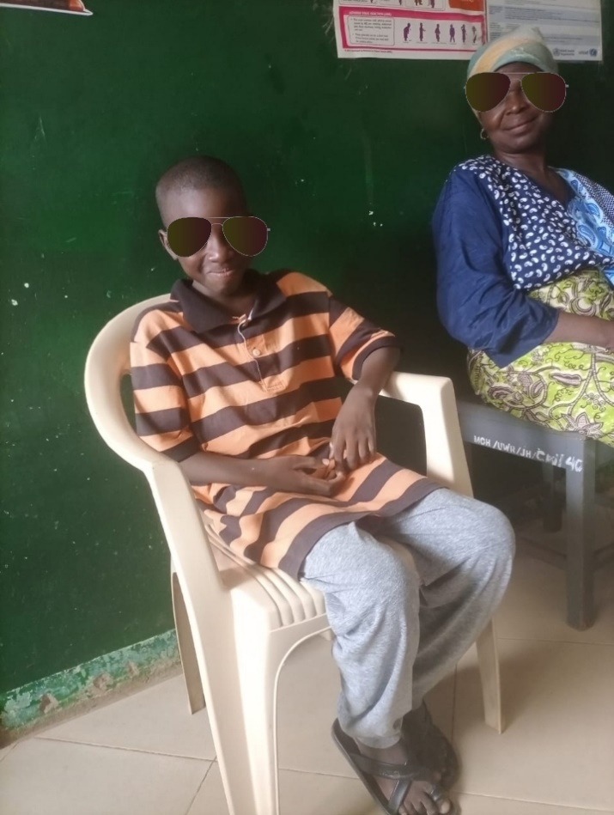
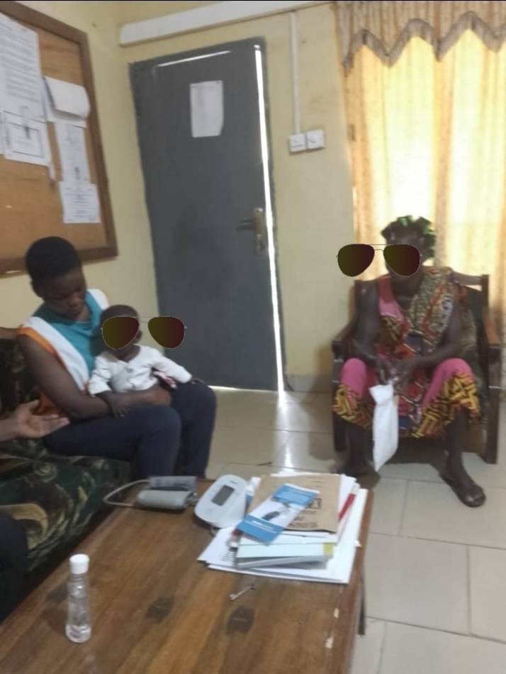
GOING THE EXTRA MILE
A CASE OF POISONING WHO WAS BROUGHT IN UNCONSCIOUS BUT RECOVERED AFTER TWO WEEKS OF DEDICATED PROFESSIONAL CARE
A CASE OF ASSAUT WITH SEVERE HEAD INJURY WHO WAS BROUGHT IN WITH POOR PROGNOSIS AND NEEDED REFERRAL. A CLINICA STAFF RAISED FUNDS ON SOCIAMEDIA AND SUCCESSFULLY FOLLOWED UP ON CHILD’S REFERRAL AND SURVIVAL.

Slide 37
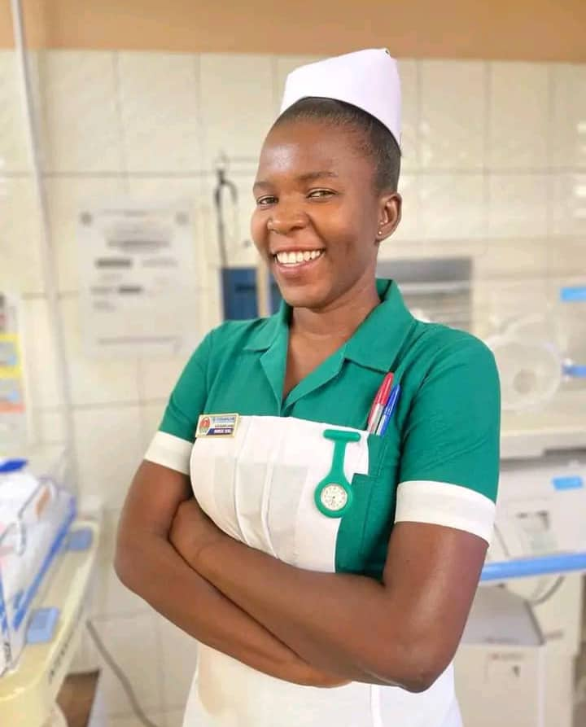
OVERALL BEST NURSE UPPER WEST REGION 2022

Slide 38
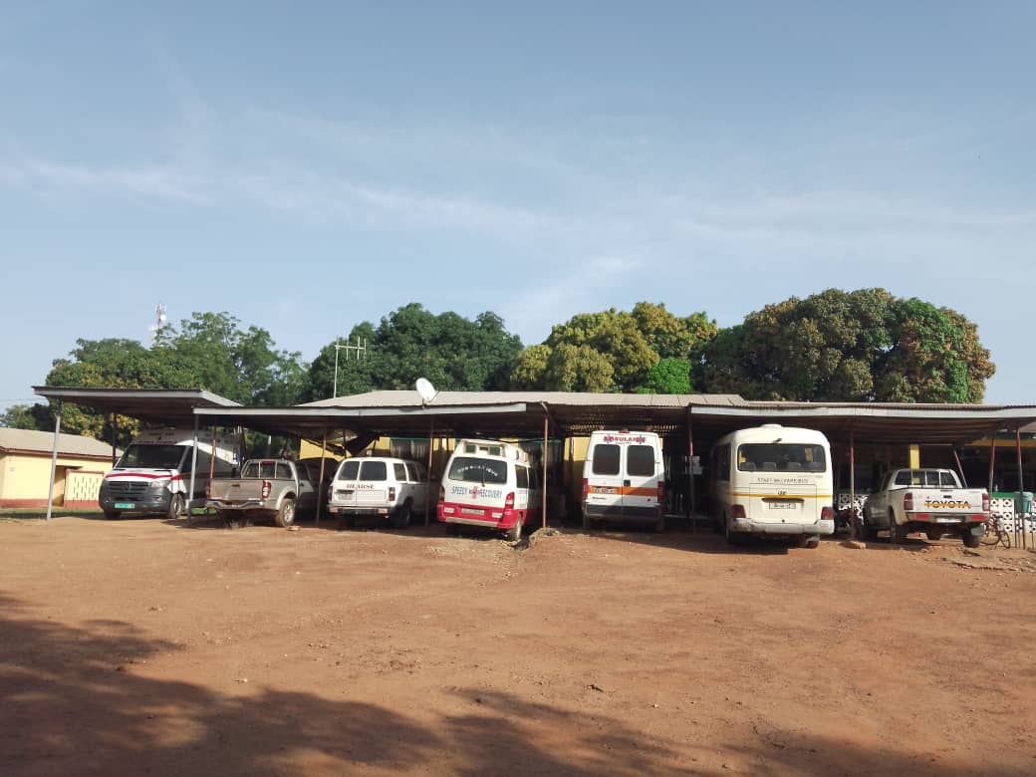
REPAIR OF HOSPITAL FLEET

Slide 39
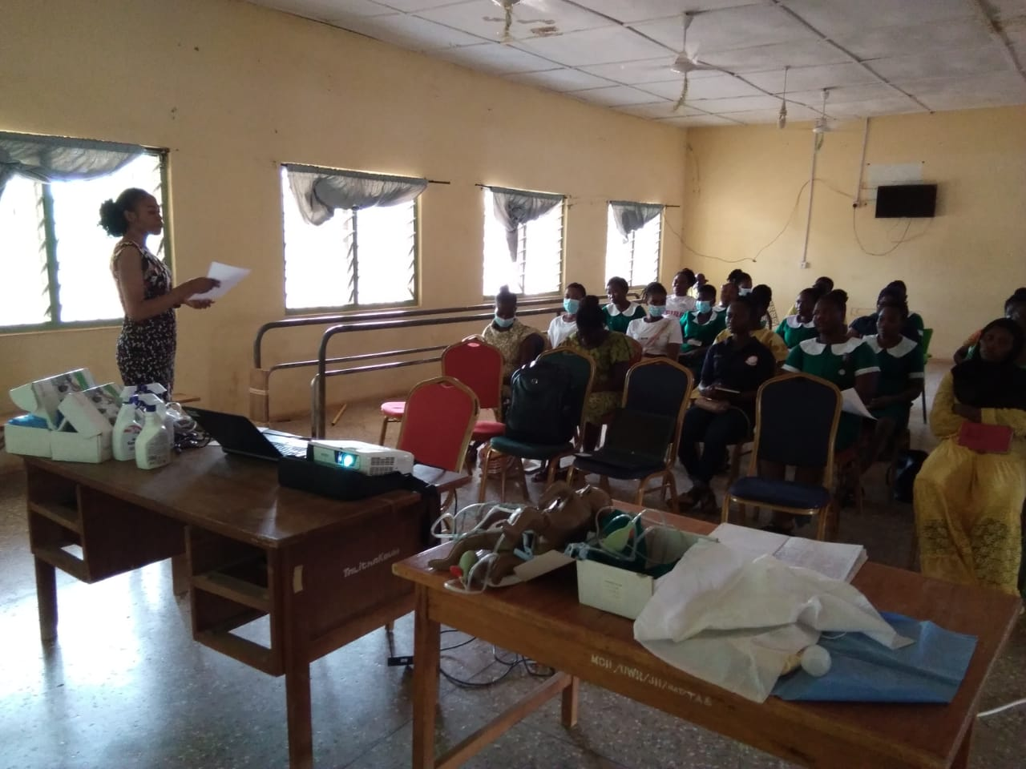
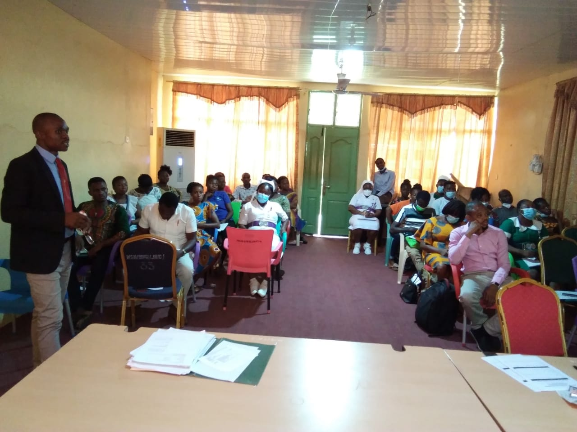
IN-SERVICE TRAINING

Slide 40
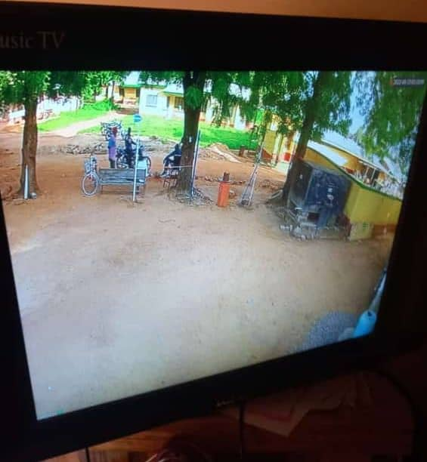
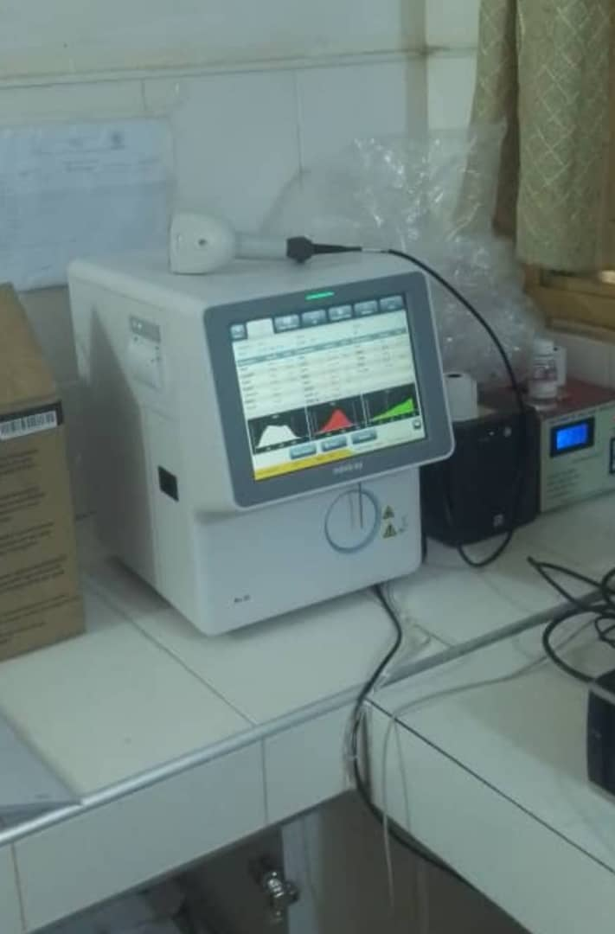
NEW HAEMATOLOGY ANALYSER
CCTV EXTENSION TO HOSPITAL ENTRANCE

Slide 41
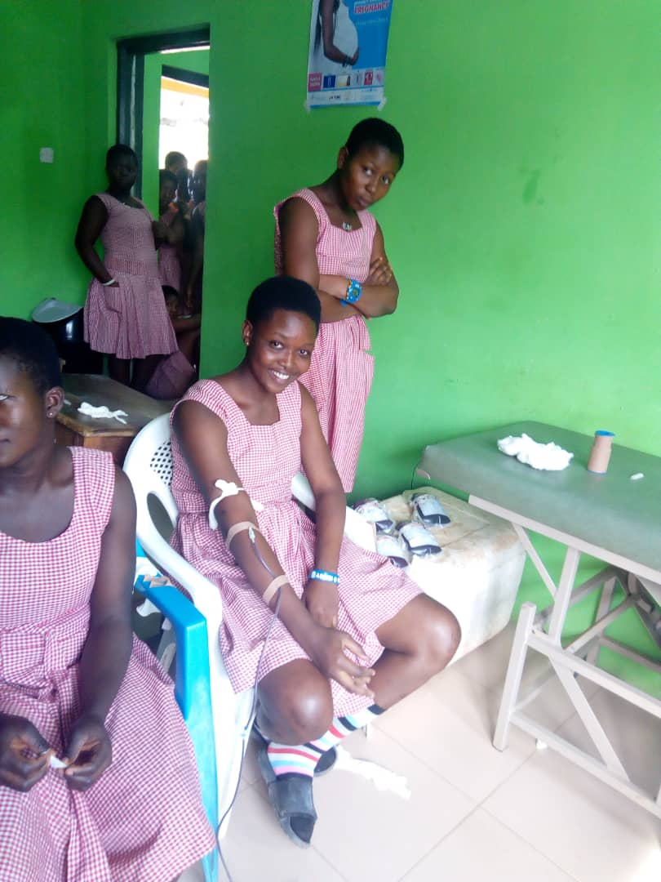
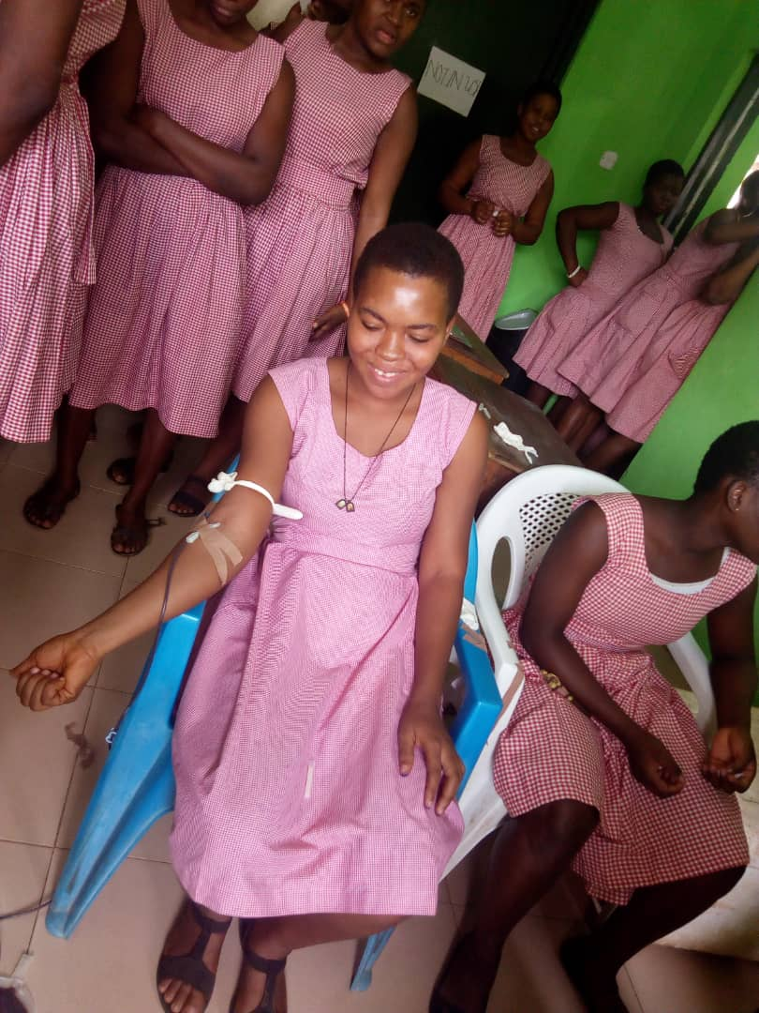
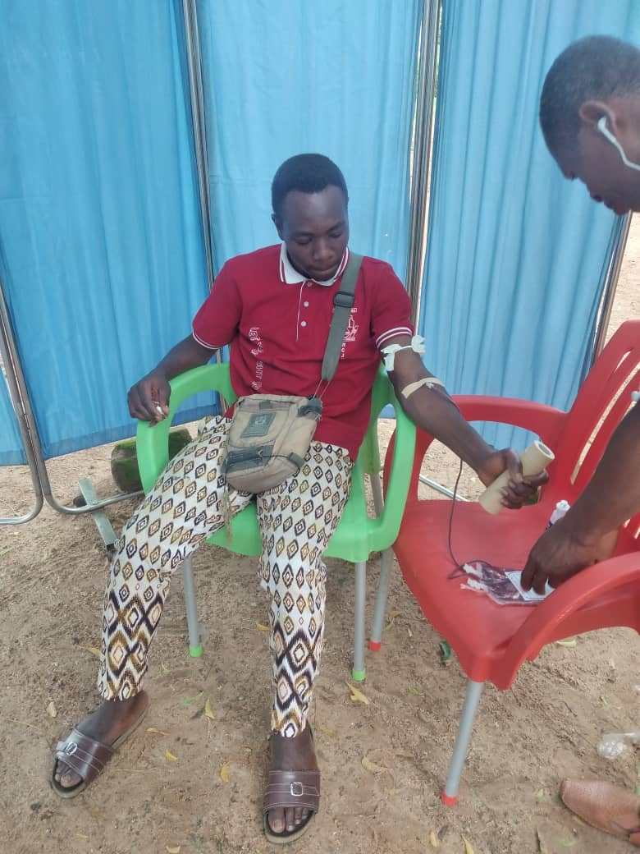
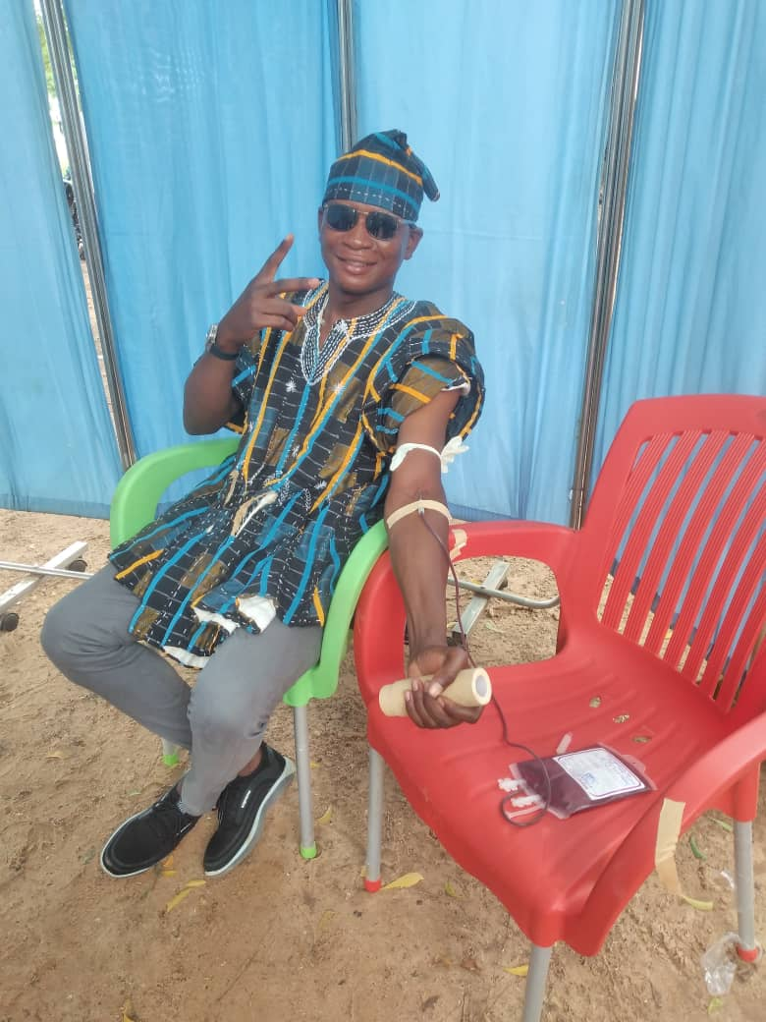
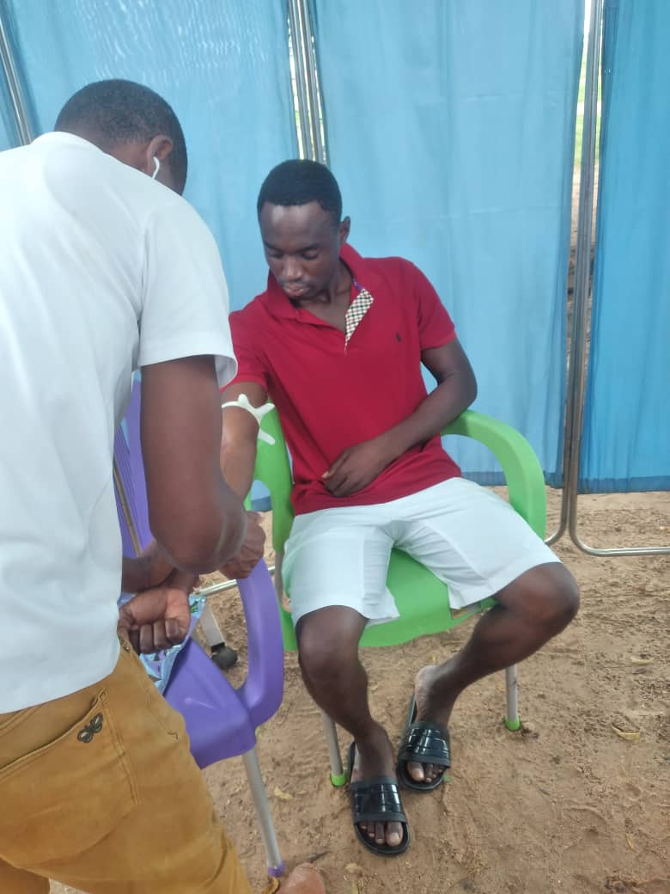
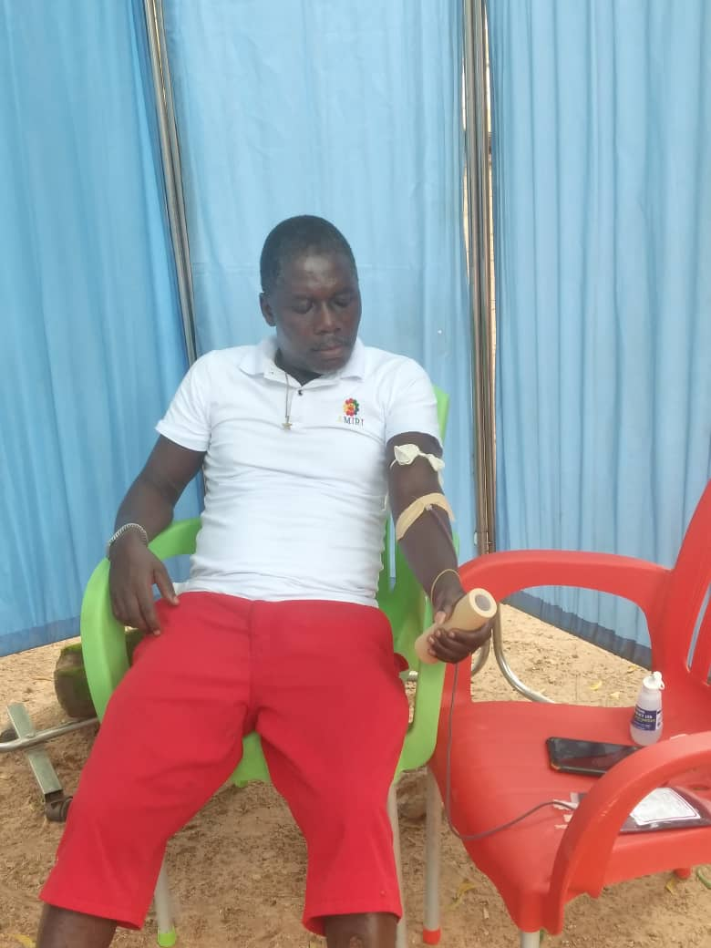
QUARTERLY BLOOD DONATION SESSIONS

Slide 42
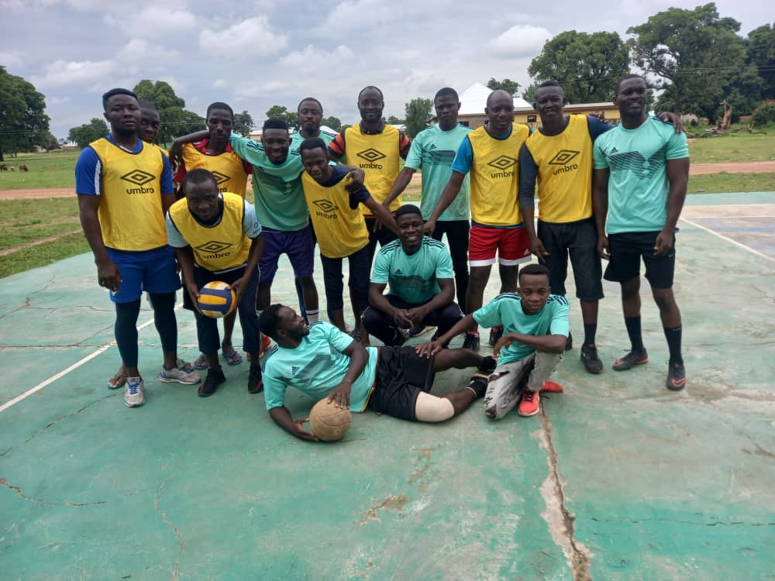
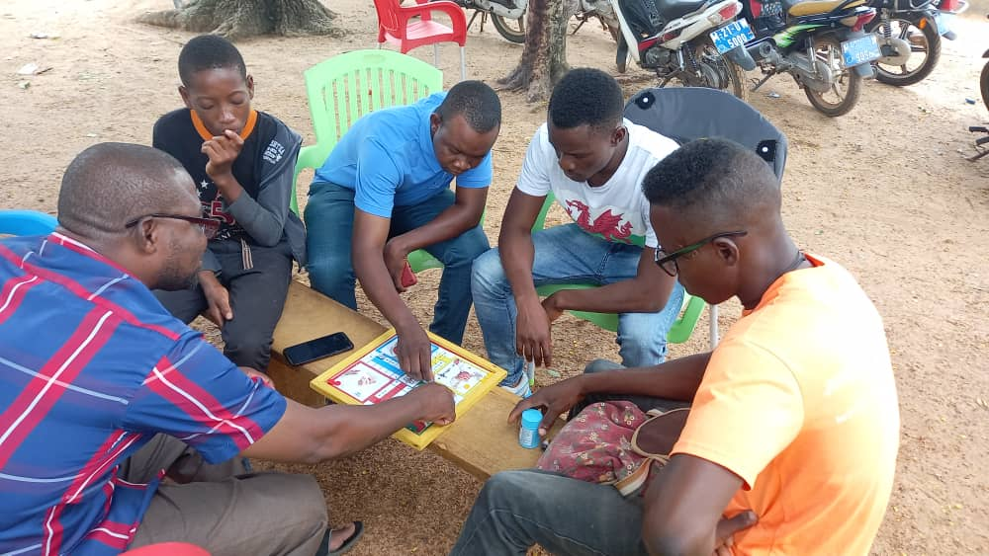
FUN GAMES:
HOSPITAL VS. MUNICIPAL HEALTH DIRECTORATE

Slide 43
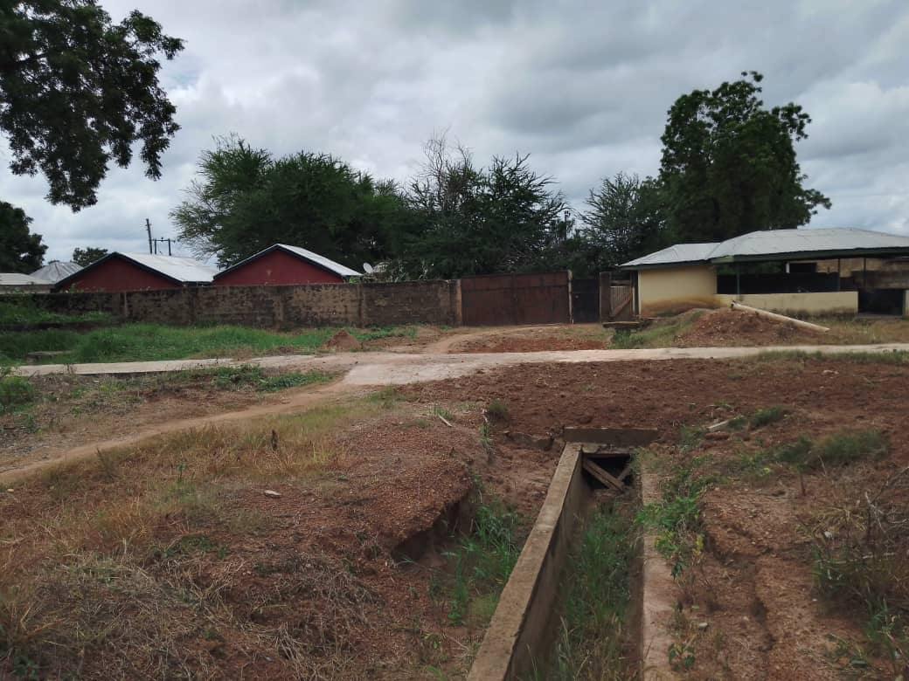
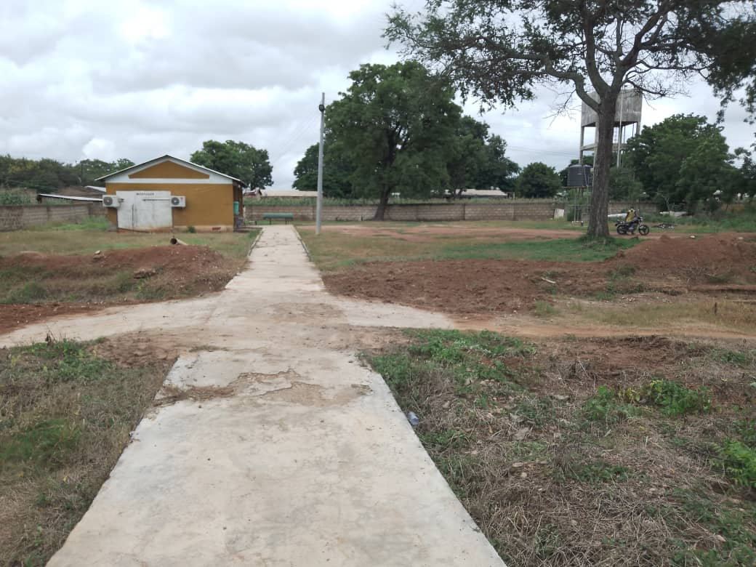
MORTUARY EXIT

Slide 44
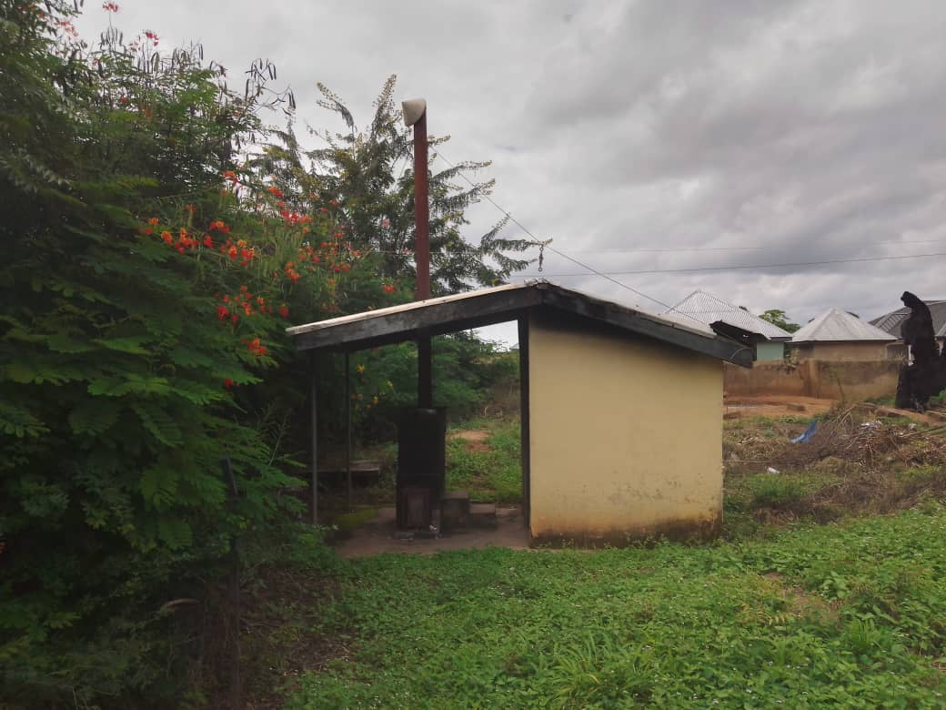
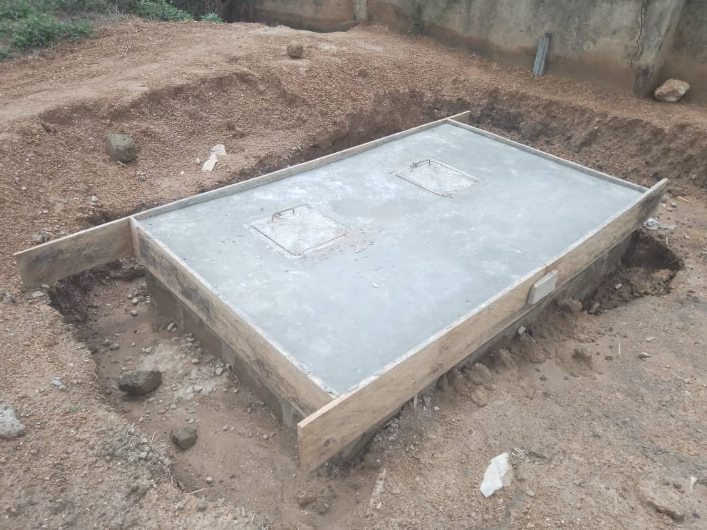
INCINERATOR

Slide 45
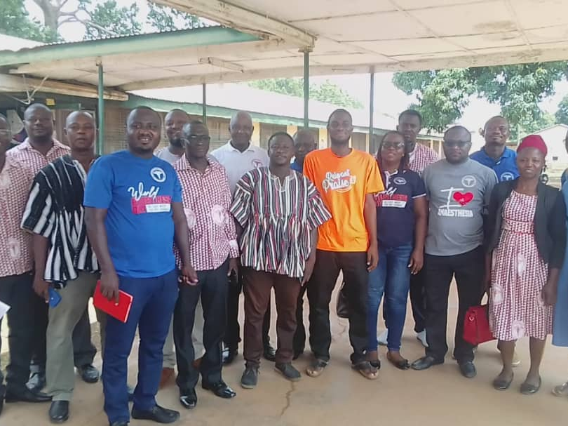
DONATION FROM GHANA ANAESTHETISTS ASSOCIATION TO CHILDREN’S WARD

Slide 46
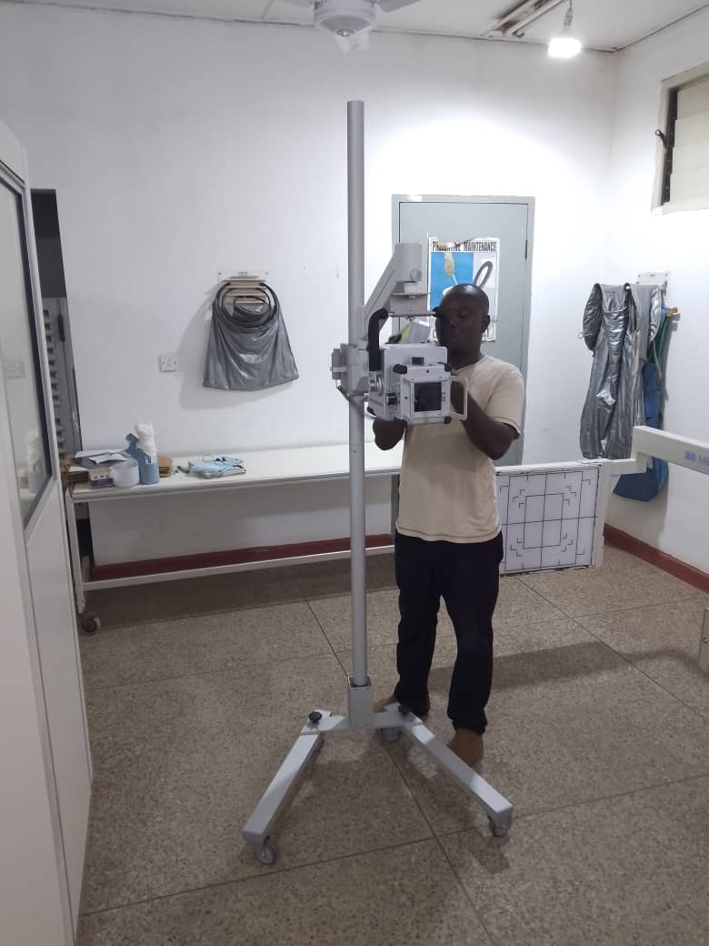
MOBILE DIGITAL X-RAY EQUIPMENT: DELFT LIGHT SOLUTION/NATIONAL TB PROGRAM

Slide 47
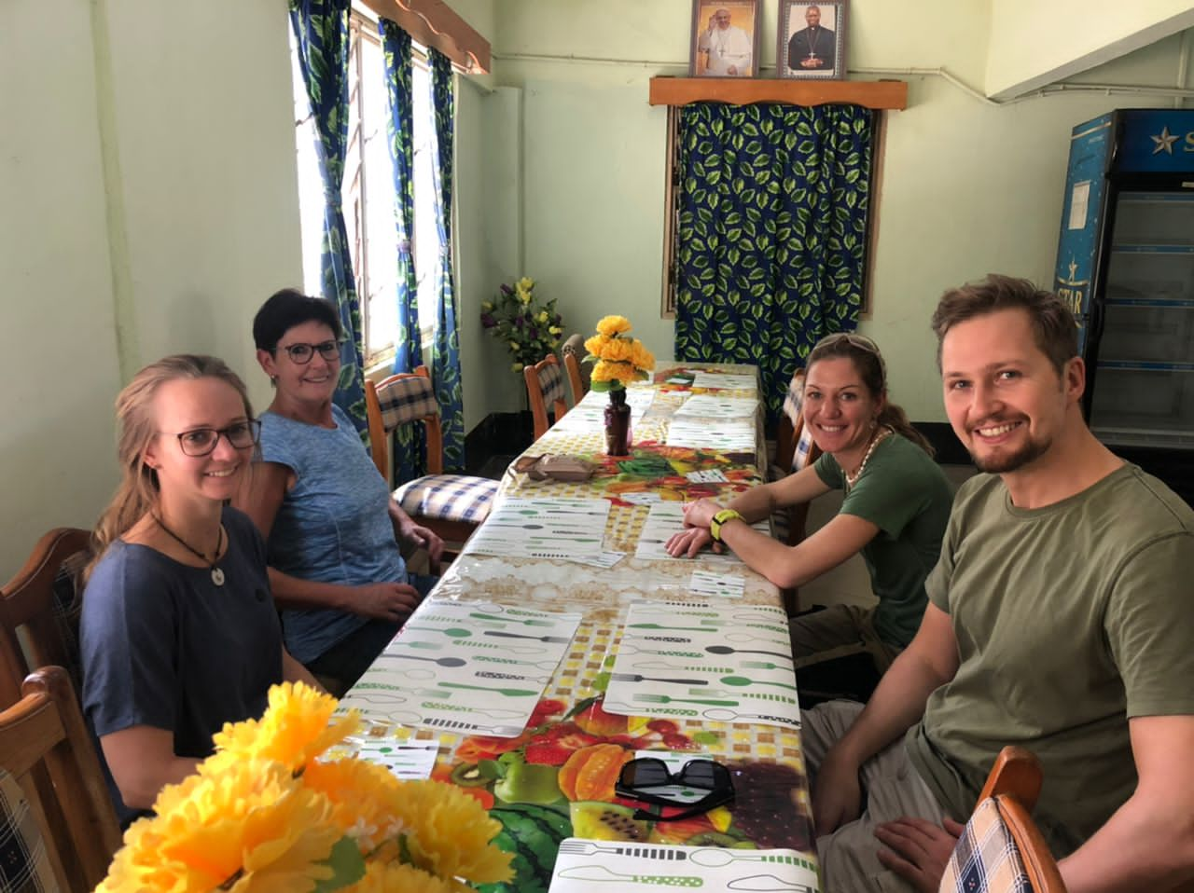
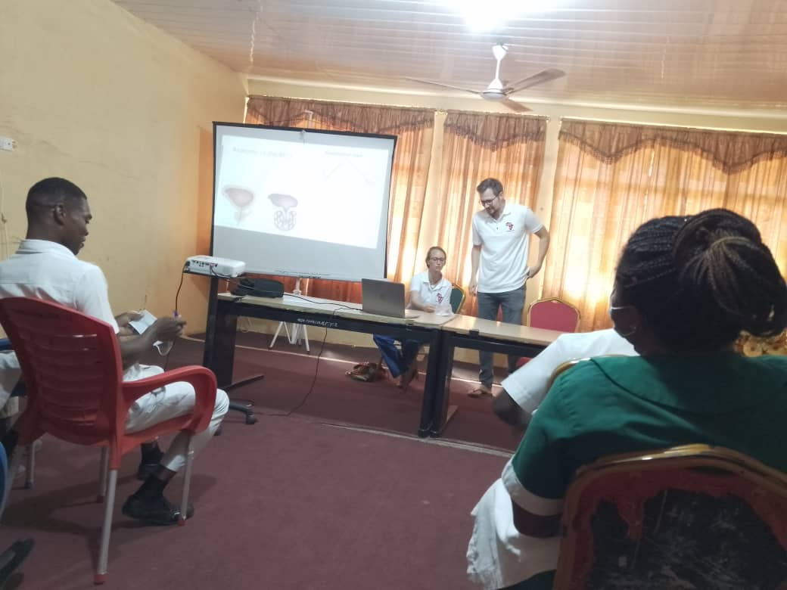
GERMAN UROLOGISTS’ VISIT

Slide 48
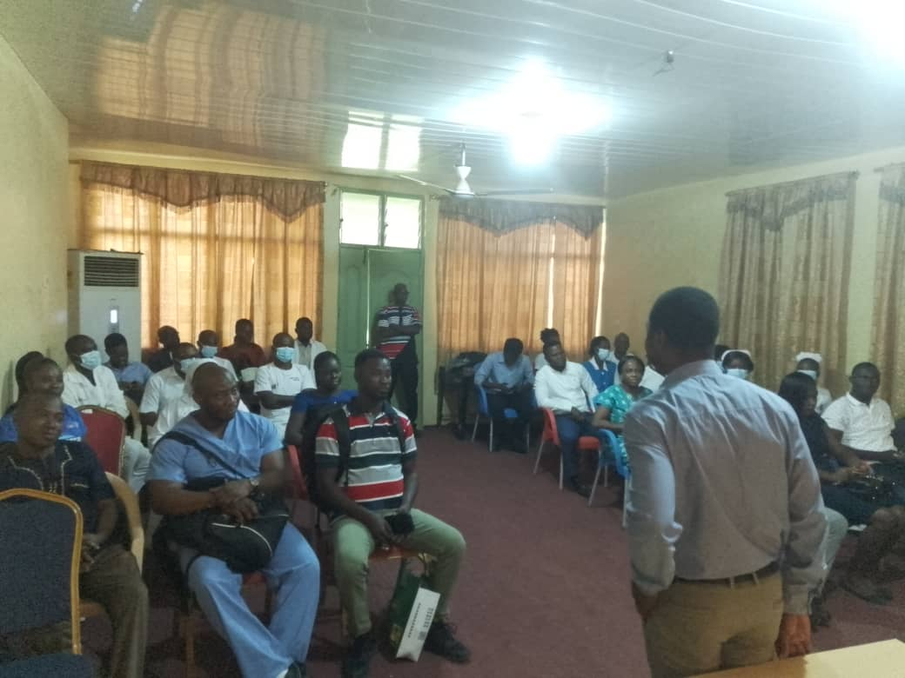
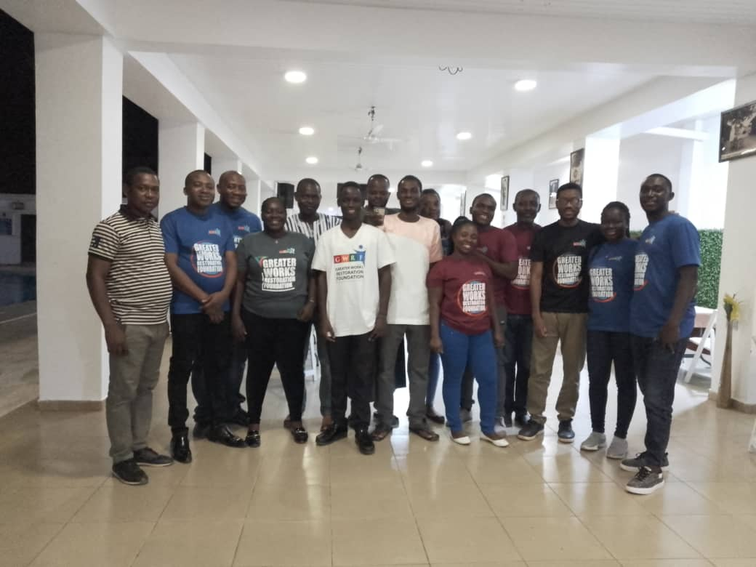
GREATER WORKS RESTORATION FOUNDATION – SURGICAL TEAM VISIT

Slide 49
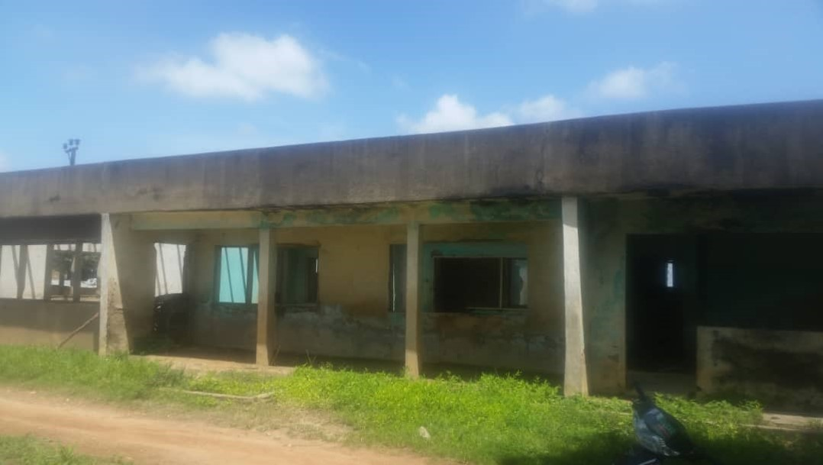

RENOVATED HOSPITAL BUNGALOW

Slide 50

DONATION FROM THE OFFICE OF THE MP FOR JIRAPA – HON. CLETUS DAPILAH

Slide 51


FRED AND ELYSE MAINDONALDS: VISIT AND DONATION

Slide 52
BAREKA!!!

